Slide 1
url Shortener
desigh steps

Slide 2
Asumptions
Short URL length – 7 characters
We expect 30 million users per month

Slide 3
Data capacity model
Long URL → 2 KB
Short URL → 17 bytes
Created → (ISODate) 20 bytes
Expired → (ISODate) 20 bytes
Clicks → 10 bytes
TOTAL: ~ 2.060 KB for a single record
30 million users per month X 12 month X 5 years X 2.060 KB = 37 TB

Slide 4
Rdbms vs nosql
RDBMS
ACID
Hard to scale
NoSQL
High availability
Easy to scale
Eventual consistency

Slide 5

B62 vs md5
MD5 algorithm generates 20-25-character token. It can create a lot of collisions – that means data corruption
B62 is in better position for greater number of tokens
${62}^{7}$ → 3.5 trillions. Even if we get 1000 hits per second, we can run for 110 years

Slide 6
Db access
Since we went with NoSQL, we can’t rely on INSERT IF ABSENT rule. The simplest scenario, prior to data insertion, would require checking for record existence. That’s because random number in B62 can’t guarantee unique token, especially if after scaled multiple application servers start working against single DB. It is possible, that at some moment two servers could generate the same random number, which would lead to the same token, and insertion collision.

Slide 7


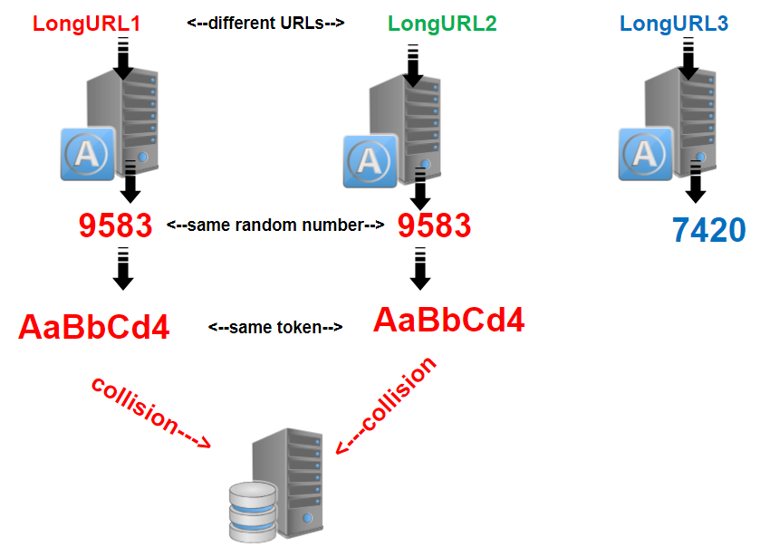

Slide 8
Using synchronization counter
Using counter would prevent from number-token collision, since the counter would provide incremented unique number for each server, seeding B62 algorithm.
It’s a good solution, but what if the counter server goes down or it runs out of numbers?
It’s possible to set several counters, but the system tends to become very complicated.

Slide 9
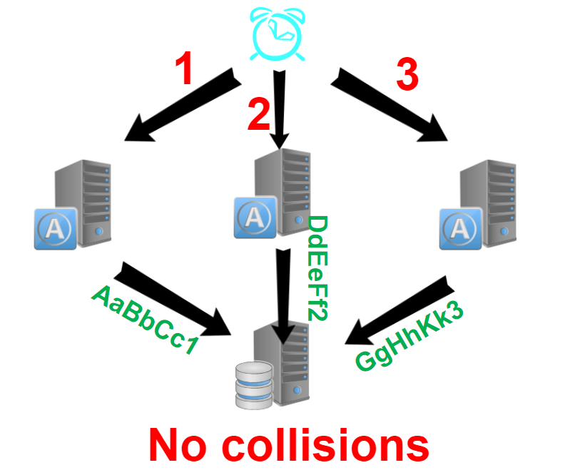

Slide 10
Final optimal solution – using zookeeper no collision guaranteed
Apache ZooKeeper is a distributed coordination service which eases the development of distributed applications.
In our distributed system ZooKeeper will provide each application server with predefined range of numbers.
Additional servers will be provided with new range as well as servers that run out of range.
This solution guarantees NO COLLISION. Therefore we can safely enter data into NoSQL, and reach highest performance.
For even better performance CACHE mechanism and LOAD BALANCER could be added.

Slide 11
